Slide 1
Internet Mapping Fundamentals
Terms, concepts, and some history

Slide 2
Today
Brief Review
Class tools
Finishing the activity!!
A brief history of web mapping

Slide 3
And now for something we’ve seen before…

Slide 4
Was everyone able to complete their website?
Let’s make a ‘first’ web page.
Please note, this is very basic, if you are familiar with html and what not - awesome, feel encouraged to help others!
Go to github.com and create a free github account.
Once you’ve done so, email me - thatchja@oregonstate.edu - with either the email address you used or the username you chose.
You should have taken care of this on Monday, but in case you haven’t, now is your chance!
Now, we’re going to create the simplest web page imaginable and host it at username.github.io (you can delete this once we’re done)

Slide 5
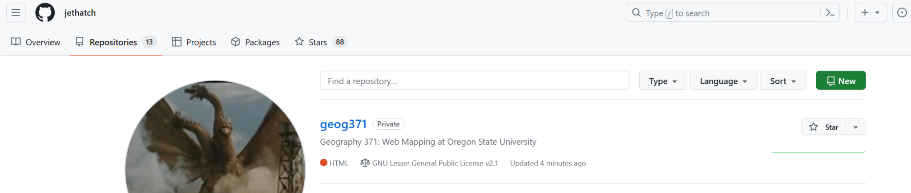
Step 1 - Create a repository
Log into Github, go to the repositories tab, and click the ‘new’ button.
Call it whatever you want, I recommend ‘helloworld’

Slide 6
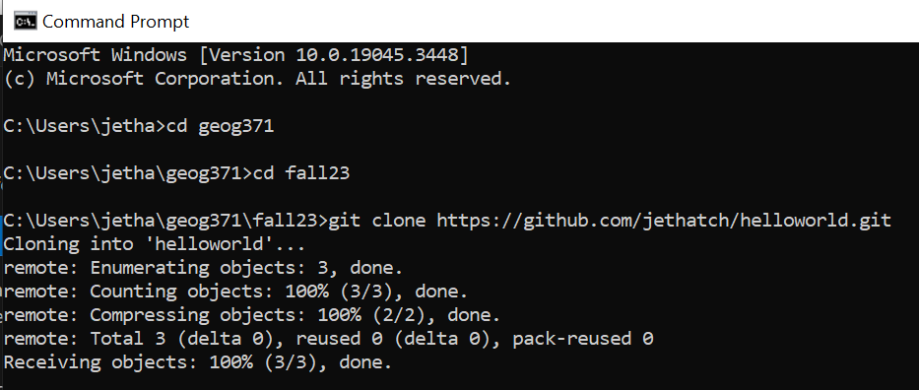
Step 2 - Clone it down…
Go to the “command prompt” on windows (you can search for ‘cmd’ and it will pop up)
Navigate to where you want to store this file (if you’re not sure, ask!)

Slide 7
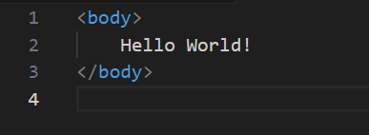
Step 3 - Create the .html
Open up Visual Studio Code and create a new file. Choose the language as .html (this is optional)
Set up your code like so and save it as index.html in the directory where you cloned the repository

Slide 8
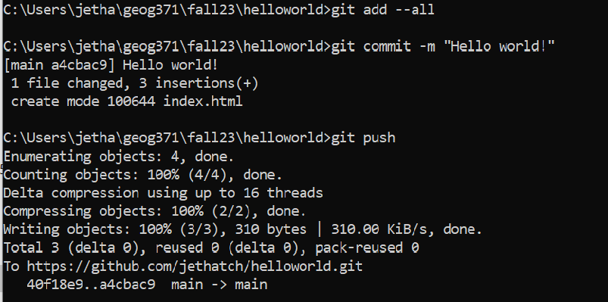
Step 4 - Time to add, commit, and push!
First, we’ll add our files to the repository. Then, we’ll commit them. Finally, we’ll push them up.

Slide 9
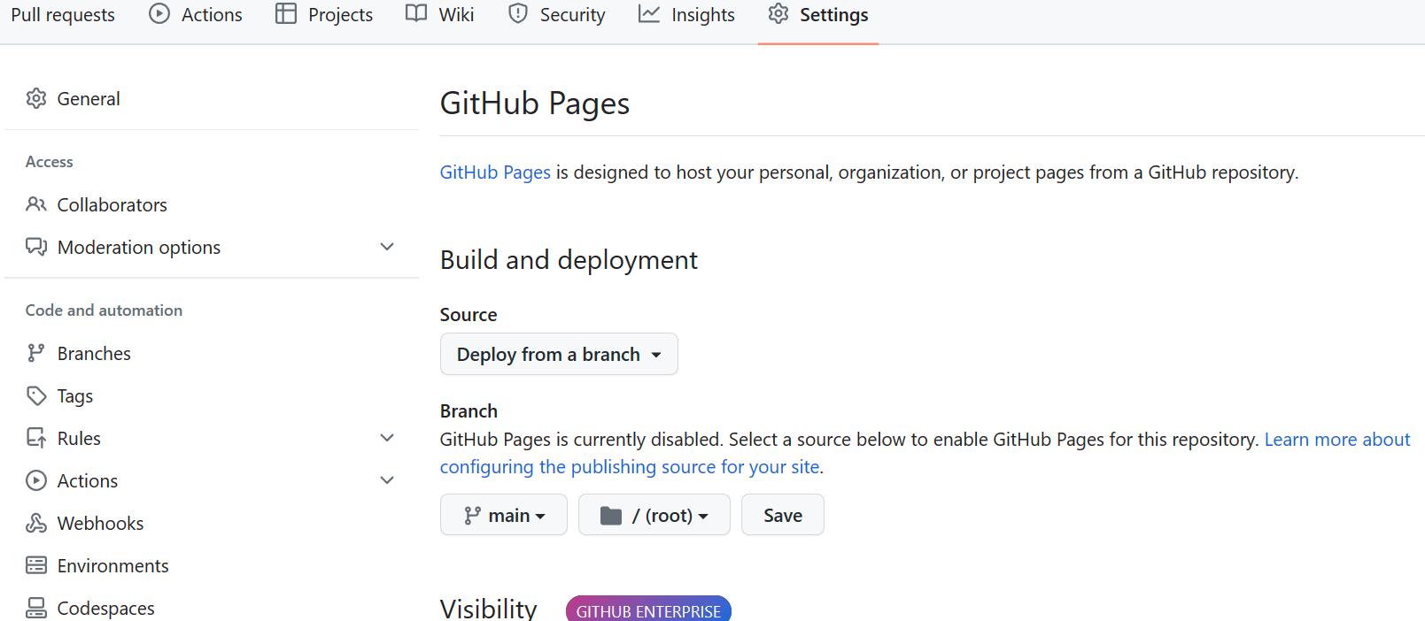
Step 5 - One last step… (which you could also do at the beginning…)
Go back to Github, go to your repository. Click on Settings, then Pages.
Set the branch to main and click save.

Slide 10
Go check it out (it may take a few moments)
Go to [username].github.io/[repository_name]/
Boom.
Yes, this was simple. However you gained experience:
Creating repositories and using Git to commit and push them.
Working with html
Using Visual Studio Code.

Slide 11
A brief history of web mapping

Slide 12

The Internet
An international network of networks communicating through various standardized communication protocols
Some of those protocols:
Email - Pop3, IMAP, SMTP, etc.
Files - FTP, bit torrent, etc.
‘Web’ - Hypertext transfer protocol (HTTP)

Slide 13
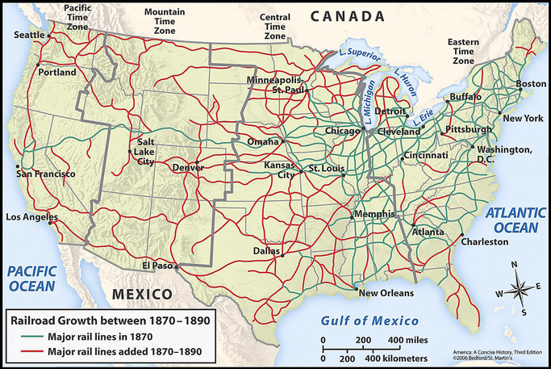
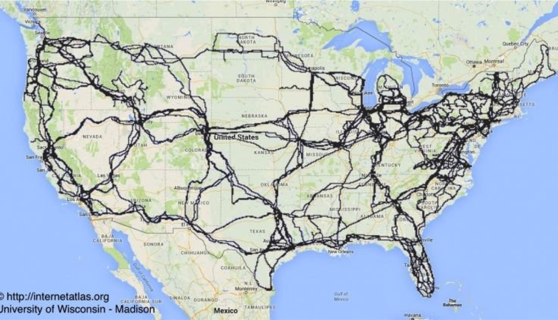
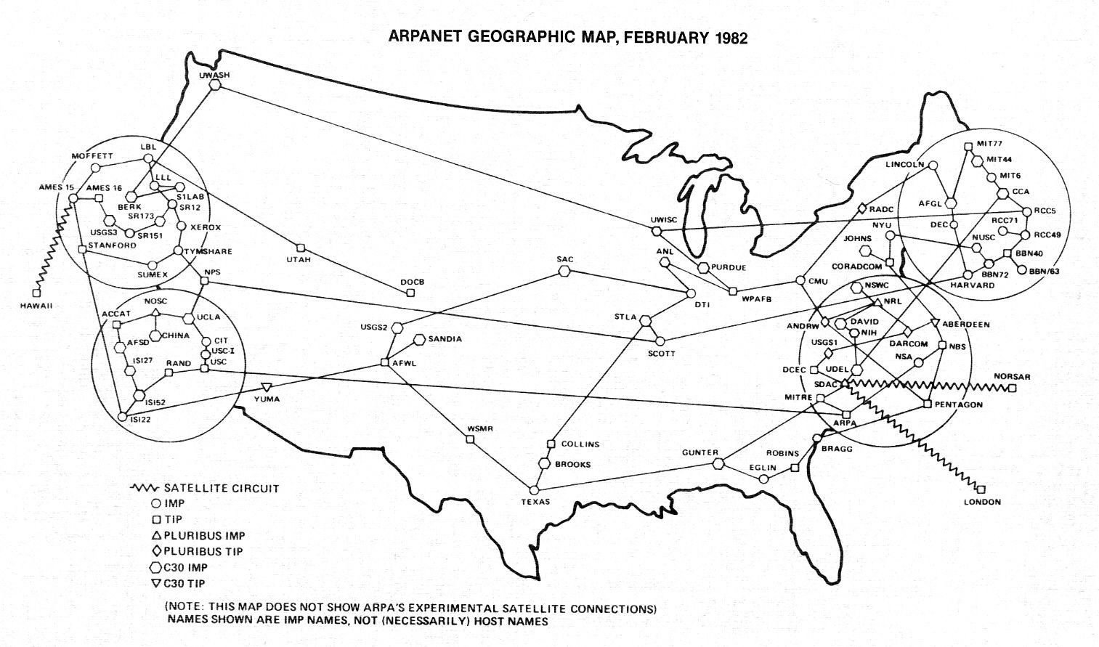
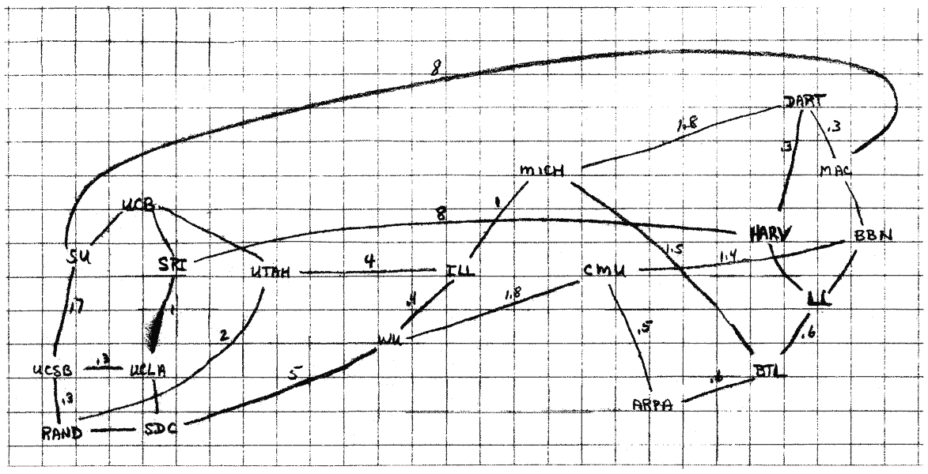
The Internet isn’t ephemeral…
… networks build on networks

Slide 14
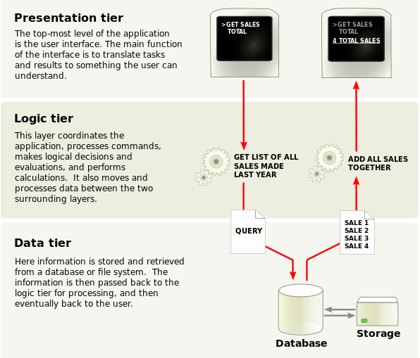
Three ‘core’ concepts of the web
Data Transmission Protocols
TCP/IP, HTTP, HTTPS, FTP, etc.
Representation Formats
HTML, CSS, XML, etc.
Addressing Standards
URI, URL
Notes:
These are separate concepts. Walk through the left. On the right: 1. Presentation tier - contents in browsers - html, js, and css - might use angular or react or whatever.
2. Application layer - processes the logic for the application - back end server computation
3. Data layer - back-end - mongo, sql, etc.
Example:
Movie times in our area on the web.
Presentation has fields that you enter the movie name and zip code.
Passed to the application layer that formats this as a query and hits the database
Database passes back the result, application formats it into a web page (or passes it along as is for the web page to format)
The page loads or updates with the formatted data.
Separation here is important - can update without taking whole stack down, can isolate issues, can scale up and out. Adds reliability.

Slide 15
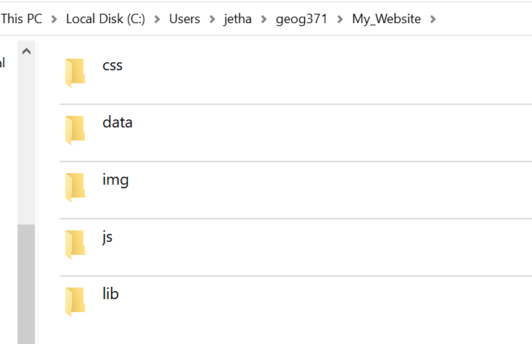
Some helpful terms
HTML - HypterText Markup Language
Primary language for ‘the web’
Invented by Tim Berners-Lee in 1989 in the particle physics CERN laboratory
First graphical browser in 1992
CSS - Cascading Style Sheet
Defines the appearance of a website
Allows separation of content and presentation!
Javascript
High-level language that runs in a web browser
Dynamic typing, object oriented… multi paradigm support
Notes:
This is the key for us. We can talk more about the others, and you should read/learn about them as you encounter them. But, for web mapping…

Slide 16
None of these were designed with mapping in mind.

Slide 17
So, how did web maps come about?

Slide 18
Was it Al Gore?
[S]he zooms in, using higher and higher levels of resolution, to see continents, then regions, countries, cities, and finally individual houses … having found an area of the planet she is interested in exploring, she takes the equivalent of a ‘magic carpet ride’ through a 3-D visualization of the terrain. Of course, terrain is only one of the many kinds of data with which she can interact. Using the systems’ voice recognition capabilities, she is able to request information on land cover, distribution of plant and animal species, real-time weather, roads, political boundaries, and population.
Gore, 1998
No.
But, also, maybe.

Slide 19
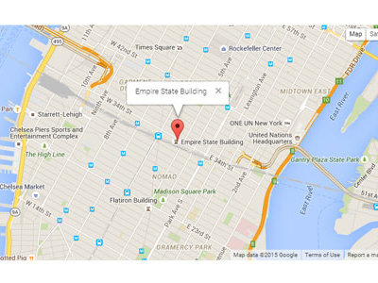
The story
In 2005 Google releases their version of Google Earth
In June, they release the Google Maps API
This is one of the first major implementations of geospatial “Web 2.0”
Notes:
Make note: An API stands for “Application Programming Interface” and it’s a way for you to ask for and receive resources and information from programs outside of your own. We’ll go over what these are in detail, but for right now, it’s important to know that what Google did was allow anyone to embed maps into their websites by making a call to their servers.

Slide 20
But it’s always already longer…
Google acquires Keyhole in October of 2004
Keyhole was supported by In-Q-Tel, the CIA’s venture capital firm (Mapbox was similarly supported)
Keyhole relied on TerraVision which was a game development firm in the 1990s
Navstar 1 launched in 1978
TRANSIT was in the 1950s
Notes:
Networks build on networks.
If have time, tell story about GPS and Bill Clinton

Slide 21
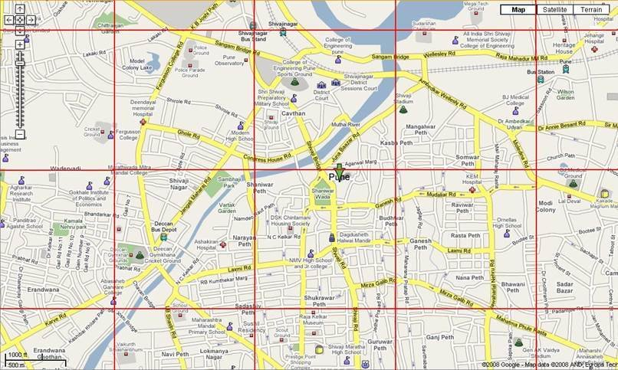
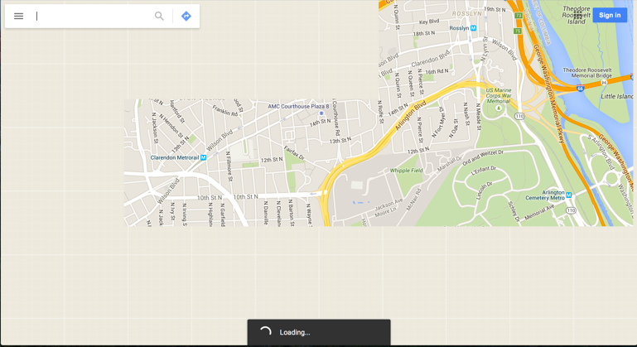
Web mapping today
Most interactive web maps are assembled out of tiles.
A grid of seamless, square portions of pre-packaged data that can be loaded onto a screen.

Slide 22
Tiles have advantages
Fast and quick to load. Easy to assemble and represent.
Can continue to load them outside of a user’s view to create a smoother pan.
A series of (relatively) established conventions:
256 x 256 pixels
Web mercator projection (both an advantage and a disadvantage, why?)
Mostly ‘established’ by Google Maps
Two broad types - Vector Tiles and Raster Tiles

Slide 23
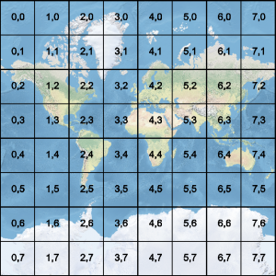
Raster Tiles
Still the most common (although changing)
Map stylings are pre-assembled and broken apart into individual tiles
May appear to be points, lines, or polygons - but those are ‘baked’ into static digital images
One advantage: fast loading times

Slide 24
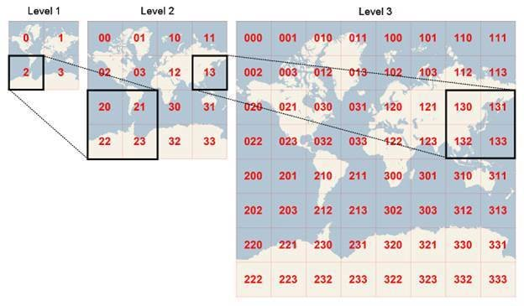
Raster Tiles
Notes:
Stepped scale of zoom levels.
The map is rendered at each level, then chunked apart. As you zoom in, more tiles are loaded.
Each ‘step’ doubles the resolution (one tile becomes four)

Slide 25
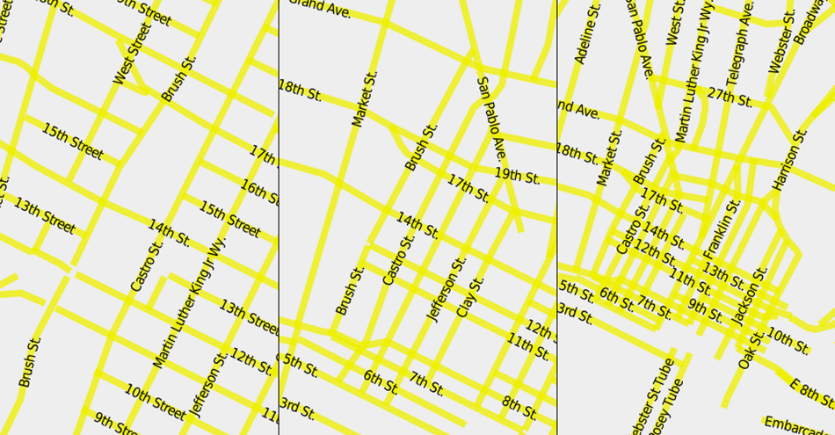
Vector Tiles
Vector data is broken into tiles
All the benefits and liabilities of vector data
Less pronounced stepping through scales
Data is repositioned according to rules as you move across scales (rather than pre-packaged at various levels)
Google Maps, Apple Maps, Mapbox, and even OpenStreetMap are all implementation vector tiles in various ways
Notes:
Note: everyone has experienced that jumble of labeling rules working at one scale and not at another. One of the major skills we’ll be working on throughout this course is designing robust maps that don’t end up looking like on the right. There are various approaches to this (including just using raster tiles).

Slide 26
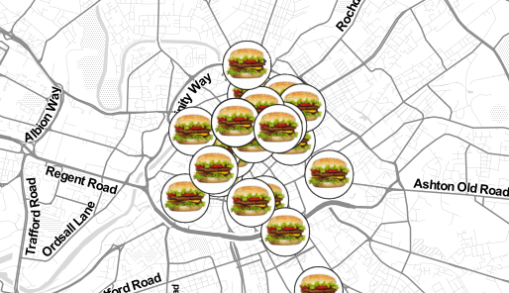
A common combination
A raster ‘base map’
Vector data on top
Roth et al. call this ‘hamburger cartography’
Literally no one else does.
We’ll be working on how you design ‘base maps’ later in the quarter with Mapbox Studio
Notes:
Image courtesy of Andrew Hill on twitter - Andrew Hill on X: "I don't get to see burger icons everyday :) http://t.co/6AgMnpeJJR http://t.co/B7122iHX3r" / X (twitter.com)

Slide 27
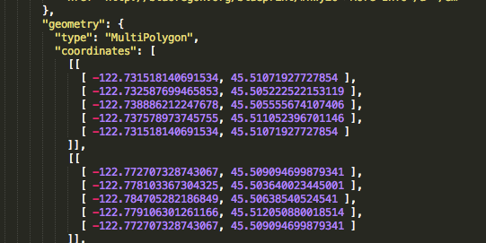
GeoJSON
Based on JSON (Javascript Object Notation)
Meant to be (relatively) human readable
A geographic vector file format used in many web maps
There are other spatial data formats, this is a common one
A bit like ‘shapefiles’ for the web (an analogy only!)

Slide 28
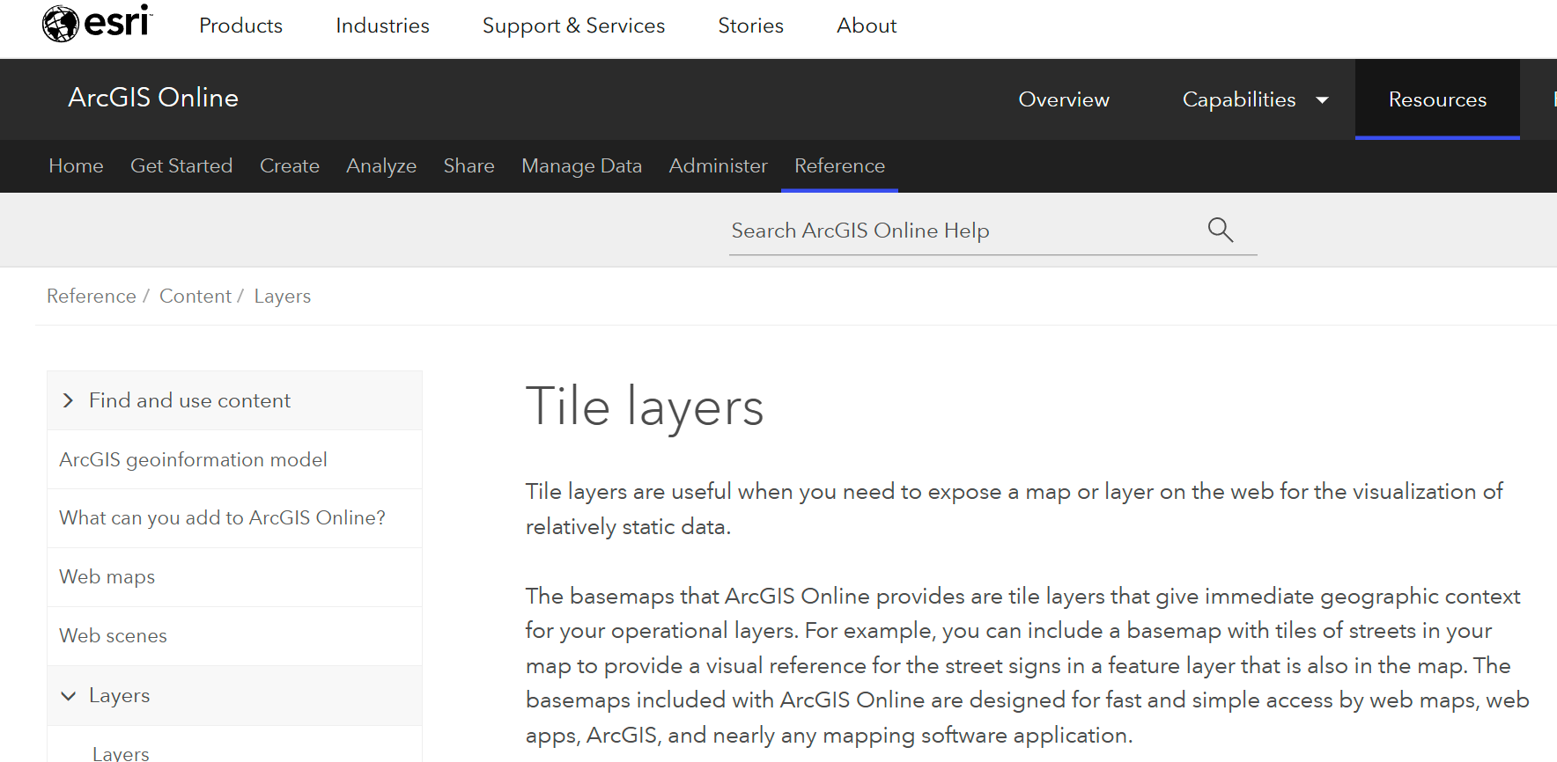
The less open web…
Much of this is able to be produced in ESRI
ESRI is excellent at taking open-source ideas and standards and incorporating them within their own ecosystem
Spatial Data Frames are directly lifted from GeoPandas, etc.
In this class, we are focusing on thinking computationally about web-mapping
Notes:
Spend some time here talking about what that means.
About how we’re learning how to learn in a jumble of ever changing software
I can’t promise that what’s covered here will be what you use in ten years, but I can promise that learning how to approach these paradigms and think through these systems will let you handle whatever might show up.

Slide 29
Some common web mapping frameworks in action

Slide 30
Google Maps
Redfin uses the google maps API

Slide 31
Mapbox
Strava’s global heatmap relies on Mapbox
Notes:
Tell fun story about military here

Slide 32
ESRI
The city of Corvallis uses ESRI
Notes:
Tell fun story about military here

Slide 33
Carto
WECC Environmental Data Viewer leverages Carto
Notes:
Carto, formerly cartoDB, has pivoted hard towards ‘analytics’ so you don’t see their full stack as often anymore

Slide 34
OpenStreetMap data undergirds many web maps

Slide 35
A short activity:
Find a web map you like
Share it with the person next to you
Compare and contrast
What technologies are used?
What is the map’s purpose?
Is it effective? Why or why not?
Notes:
Where might you look? Newspapers, specific apps, etc.

